Slide 1
COCO COLA RETAILER ANALYSIS
EXCEL

Slide 2

TOOL USED EXCEL

Slide 3
STEP 1
Create a pivot table
Add a operating margin,operating profit,total sale and total units in the values
Those 4 margin ,profit,total sales and unit are numeric so we should add in values

Slide 4
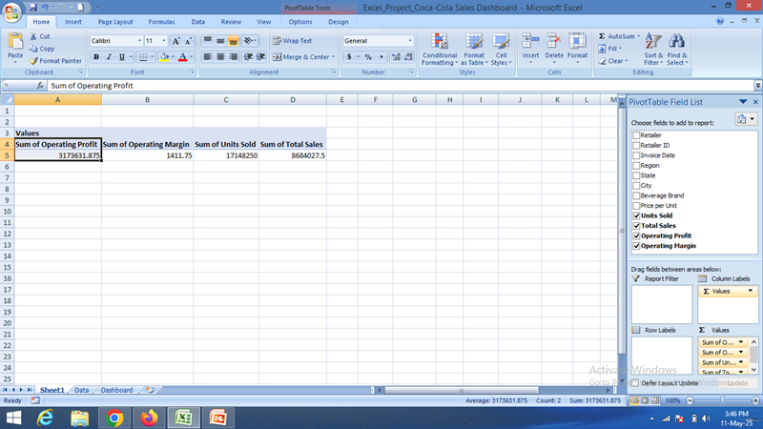

Slide 5
STEP 2
Add the unit sold,sales,operating margin,and profit in the dashboard
Give a “=“ symbol and go to the sheet where we created a pivot table click on the particular value and press enter

Slide 6
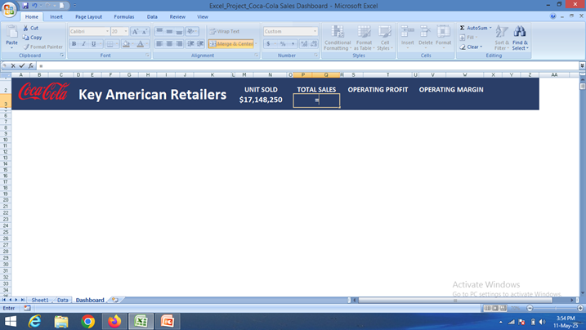

Slide 7
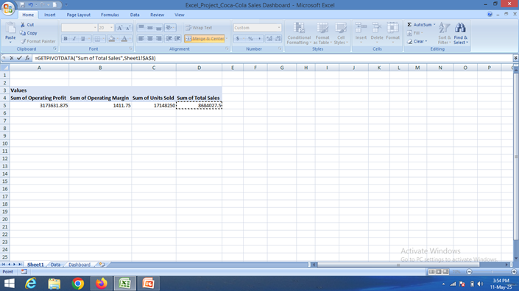

Slide 8
STEP 3
Create a pivot table for month and sum of units sold
Add unit sold in values
Add invoice date in rows and remove the date when you get month
And click on the pivot table and create a chart

Slide 9
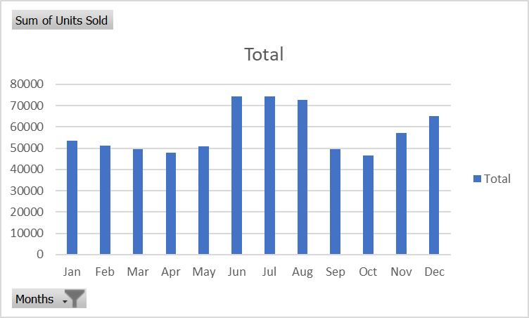

Slide 10
STEP 4
Creating a PivotTable Timeline:
1. Insert a PivotTable:If you don't have a PivotTable, create one from your data.
 2. Analyze > Insert Timeline:Click on a cell within your PivotTable, go to the "Analyze" tab, and select "Insert Timeline".
 3. Select Date Fields:In the "Insert Timeline" dialog box, check the boxes for the date fields you want to use for filtering, and click "OK".
4. Filter Data:Use the timeline controls (e.g., dragging handles, selecting time periods) to filter your PivotTable data by date

Slide 11
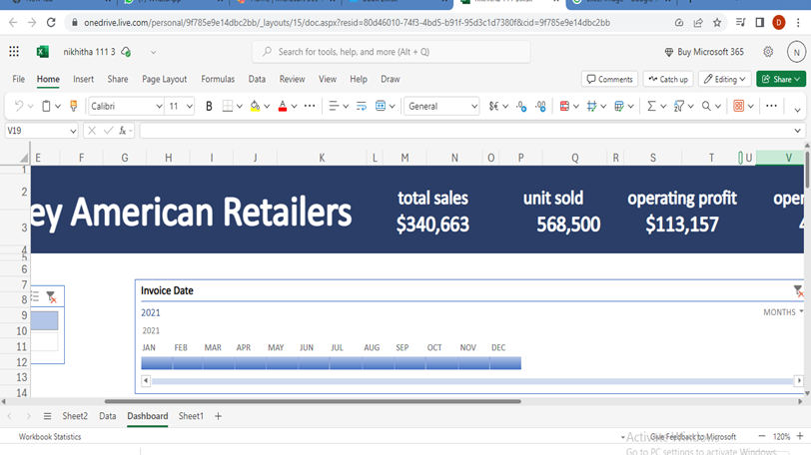

Slide 12
STEP 5
Here's a general outline of how to add a slicer:
Choose a Tool: Determine if you are using Excel with PivotTables or Power BI.
 Create the PivotTable/Data Source: If using Excel, create a PivotTable from your data. In Power BI, ensure your data is loaded and connected.
 Select the PivotTable/Report: In Excel, click anywhere within the PivotTable. In Power BI, navigate to the report page where you want the slicer.
Insert Slicer:Excel: Go to the "Insert" tab, then "Slicer". Select the fields you want to filter by.

Slide 13
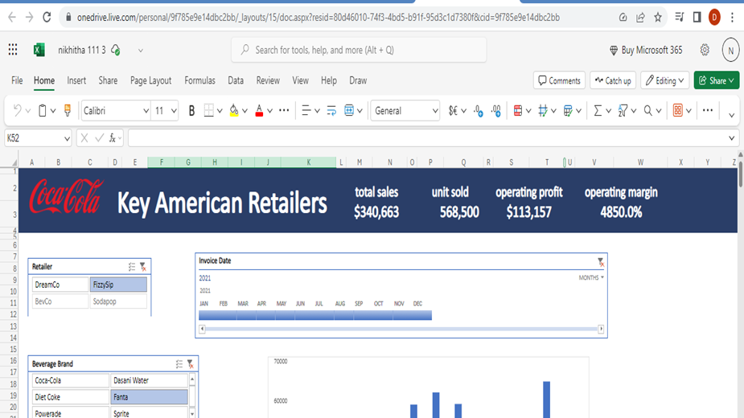

Slide 14
STEP 6
Steps to Connect:
Create a PivotTable: Select your data, go to "Insert" > "PivotTable".
Insert Slicer: Go to "Analyze" > "Insert Slicer" and choose the field you want to filter (e.g., category, region).
Insert Timeline: Go to "Analyze" > "Insert Timeline" and choose the date field you want to use.
Create PivotChart: Go to "Analyze" > "PivotChart" and choose a chart type.Report Connections (Optional): Select the slicer, go to "Slicer Tools" > "Options" > "Report Connections" and select the PivotChart to connect it.
Test and Adjust: Interact with the slicer and timeline to see how they filter the PivotChart data.
Steps to Connect:
Create a PivotTable: Select your data, go to "Insert" > "PivotTable".
Insert Slicer: Go to "Analyze" > "Insert Slicer" and choose the field you want to filter (e.g., category, region).
Insert Timeline: Go to "Analyze" > "Insert Timeline" and choose the date field you want to use.
Create PivotChart: Go to "Analyze" > "PivotChart" and choose a chart type.Report Connections (Optional): Select the slicer, go to "Slicer Tools" > "Options" > "Report Connections" and select the PivotChart to connect it.
Test and Adjust: Interact with the slicer and timeline to see how they filter the PivotChart data.

Slide 15
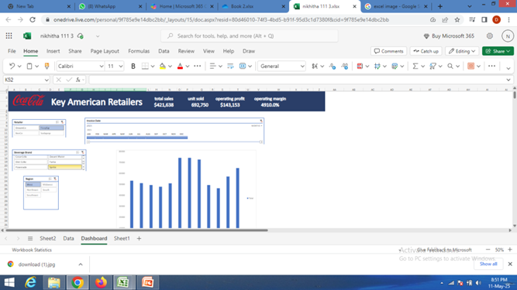

Slide 16
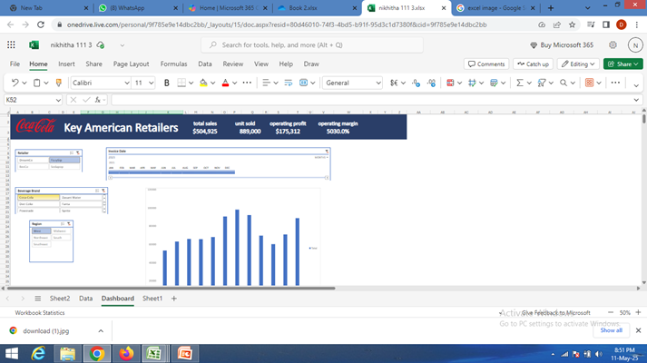

Slide 17
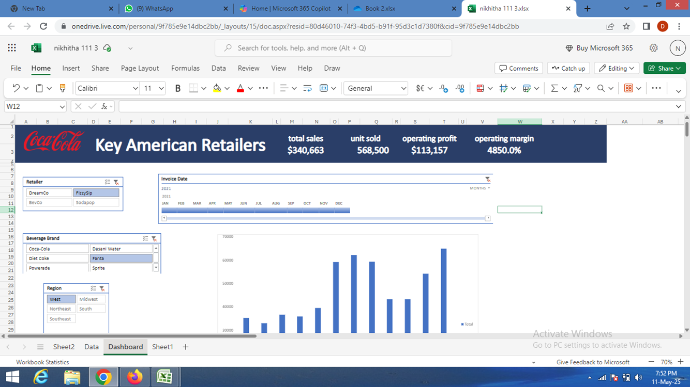

Slide 18
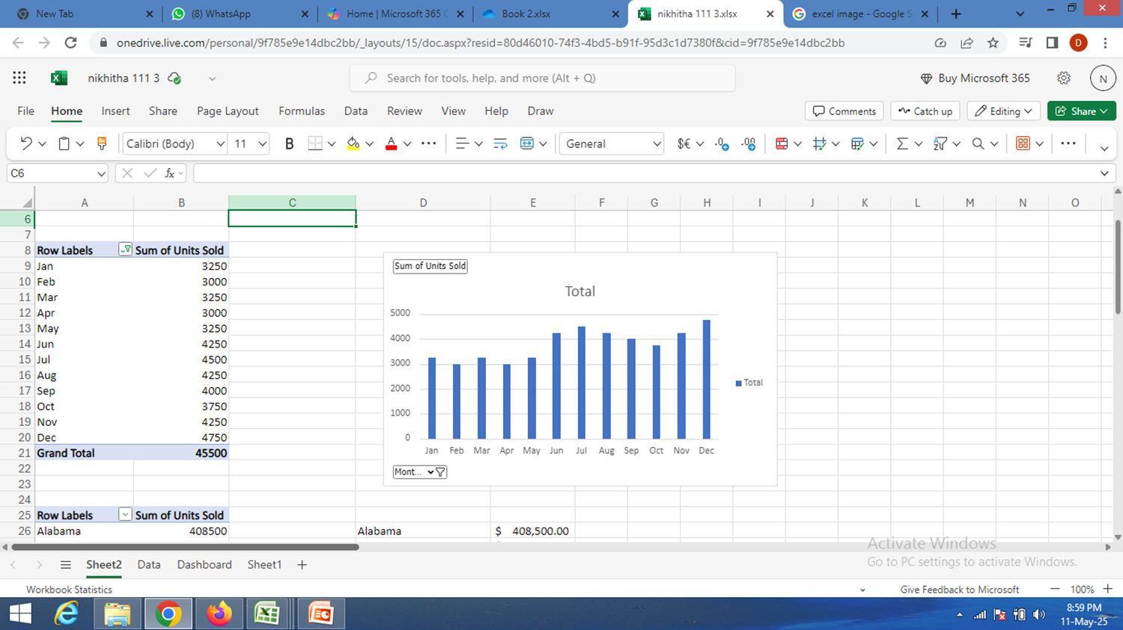

Slide 19
THANK YOU PREPARED BY NIKHITHA J GADAD

